Slide 1
Capstone Project
Group 2

Slide 2

Discover Phase

Slide 3
User Research

Slide 4
User Interview | Middle-Aged, HNW, Married Adult
Challenges: Balancing monthly expenses and savings goals, unexpected costs like medical bills or school expenses, and managing due dates for bills.
Impact of Defaults: Hurt credit score, harder to get good interest rates, added late fees, and difficulty in managing the budget.
Needed Tools/Resources: Better system to track and manage bills, automated reminders for payment due dates, and access to personalized financial advice.
Specific Instance: Missed credit card bill due to an unexpected medical expense, leading to a high late fee and difficulty paying for other necessities.

Slide 5
User Interview | Single, Young Professional
Challenges: Balancing high outstanding bills (e.g., student loans) with day-to-day expenses, unexpected expenses, and poor planning.
Impact of Defaults: Messed up financial plans, affected credit score, extra fees, and interest making debt harder to pay off.
Needed Tools/Resources: Better financial planning tools integrating all expenses and income streams, automated alerts and reminders, and personalized advice on managing student loans and other debts.
Specific Instance: Missed student loan payment due to an unexpected car repair, leading to a significant late fee and added interest.

Slide 6
User Interview | Middle-Aged, LNW, Married Adult
Challenges: Limited income barely covering basic expenses, unexpected costs pushing her over the edge, and not having enough money to cover everything.
Impact of Defaults: Extra stress from late fees, damaged credit score, harder to get financial help or better rates, and a cycle that's hard to break.
Needed Tools/Resources: Simple, clear financial advice, effective expense tracking tools, automated reminders, and flexible payment options.
Specific Instance: Missed utility bill payment, resulting in a significant late fee and higher subsequent bill, requiring borrowing money from a friend.

Slide 7
User Interview | Single, Recent Graduate
Challenges: Managing student loans while covering living expenses, relatively low income, and unexpected costs.
Impact of Defaults: Added extra fees, damaged credit score, constant stress of being behind on payments, and difficulty building a good financial foundation.
Needed Tools/Resources: Better budgeting tools designed for managing student loans and low income, automated reminders for payment due dates, and personalized financial advice.
Specific Instance: Missed credit card payment due to an unexpected medical bill, resulting in a high late fee and difficulty covering rent.

Slide 8
Synthesis (Personas)

Slide 9
Judy, 39 | Marketing Manager
Real Quotes
Identifiers
Background
High net worth, middle-aged married woman
University Educated
Dedicated to managing family's finances and ensuring financial stability
Demographics
Income Level: High
Marital Status: Married
Education Level: Bachelor's Degree
"I need to ensure our family’s financial health and manage our bills efficiently."
"Balancing our family’s budget is getting tougher, and I need better planning tools."
"I want to improve our financial security for the future."
Financially Stable | Family-Oriented
Budget Conscious | Detail-Oriented

Slide 10
Judy, 39 | Marketing Manager
Goals
Ensure financial stability for her family.
Efficiently manage household expenses.
Plan for future financial security.
Pain Points
High outstanding unpaid bills.
Balancing expenses and savings.
Finding time to manage finances amidst a busy family life.
Needs
Access to personalized financial advice.
Tools to track and manage household expenses.
Support in reducing unpaid bills and optimizing savings.

Slide 11
Alex, 31 | Software Engineer
Real Quotes
Identifiers
"I want to ensure I am on track with my finances and avoid missing payments."
"Balancing my bills and savings is challenging, and I need better management tools."
"I need advice on building a secure financial future without constant worries."
Background
Young, single post-graduate
Medium Net Worth
Focused on building financial security and managing expenses effectively
Demographics
Income Level: Medium
Marital Status: Single
Education Level: Post-Graduate
Career-Oriented | Financially Aware
High Achiever | Goal Oriented

Slide 12
Alex, 31 | Software Engineer
Goals
Build long-term financial security.
Manage expenses effectively.
Increase savings and investment opportunities.
Pain Points
High outstanding unpaid bills.
Balancing expenses with savings.
Navigating complex financial decisions.
Needs
Tools for effective expense management.
Access to financial planning and advice tailored to his career goals.
Support to maintain a good credit score.

Slide 13
Mary, 39 | Administrative Assistant
Real Quotes
Identifiers
"I need help understanding how to manage my finances better."
"I feel lost with all the financial jargon and don’t know where to start."
"I want to find simple ways to manage my money without stress."
Background
Middle-aged, married
Keen on improving financial literacy and managing her expenses more effectively
Demographics
Income Level: Low
Marital Status: Married
Education Level: Bachelor's Degree
Financially Struggling | Knowledge Seeker
Limited Savings | Financially Insecure

Slide 14
Mary, 39 | Administrative Assistant
Goals
Improve her financial literacy and understanding.
Better manage her expenses.
Find ways to save money and reduce financial stress.
Pain Points
Managing expenses with limited income.
Lack of understanding of financial products and services.
Financial stress and uncertainty.
Needs
Simple and clear financial advice.
Tools to manage expenses and optimize savings.
Support to improve financial literacy and confidence.

Slide 15
Jessica, 27 | Marketing Associate
Real Quotes
Identifiers
"Managing my finances efficiently is crucial to building a strong financial foundation for my future."
"I need tools to keep track of my bills and manage my budget effectively."
"I want to learn how to build a good credit score and avoid any financial pitfalls."
Background
Recent University graduate with medium net worth
Focused on managing student loans and building strong financial foundation for her future
Demographics
Income Level: Medium
Marital Status: Single
Education Level: Bachelor’s Degree
Fresh Graduate | Financially Conscious
Ambitious | High Potential

Slide 16
Jessica, 27 | Marketing Associate
Goals
Manage student loans and build a strong credit history.
Balance her budget while saving for future goals.
Develop a solid financial foundation for her future.
Pain Points
High outstanding unpaid bills/loans.
Managing expenses and savings.
Navigating financial planning and advice.
Needs
Budgeting tools tailored to young professionals.
Support to build and maintain a good credit history.
Educational resources on financial planning and management.

Slide 17
Define

Slide 18
Concept Generation

Slide 19
Creative Matrix
 | HOW MIGHT WE...provide intuitive and accessible financial management tools? | HOW MIGHT WE…help users balance savings goals with managing high bills and debts | HOW MIGHT WE...streamline managing multiple bills and payment due dates? | HOW MIGHT WE...integrate technology to automate routine financial tasks and provide alerts?
Middle-Aged, High Net Worth, Married Adult | Bill management tool with family reminders | Automated payment reminders and alerts for bills | Flexible payment plans for household expenses | Programs to improve credit scores with personalised guidance
Single, Young Professional | Integrated bill management with expense tracking | AI-powered financial management with automated alerts | Flexible repayment plans for managing debts and expenses | Comprehensive credit improvement program and tools
Middle-Aged, Low Net Worth, Married Adult | Simple bill tracking reminder system | Essential payment reminders to avoid missed payments | Options for partial payments or extended payment periods | Credit repair programs and support for improving credit scores
Single, Recent Graduate | Loan Repayment and reminders | Automated loan payment schedules and savings alerts | Flexible student loan repayment options | Student loan management programs to improve credit scores

Slide 20
Concept Prioritisation

Slide 21


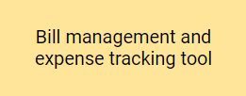

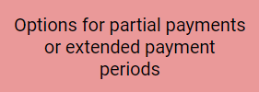

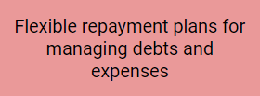

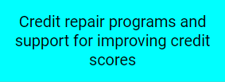
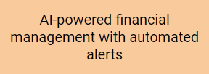
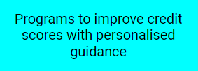

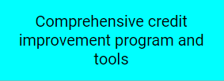

Impact vs Difficulty Matrix
Impact
Difficulty

Slide 22
Customer
Value
Proposition

Slide 23
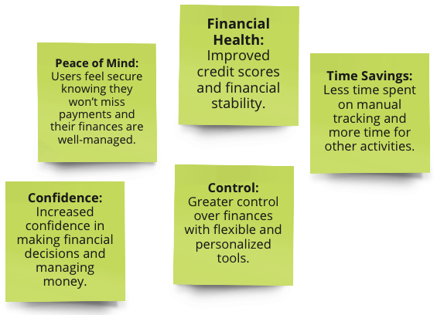
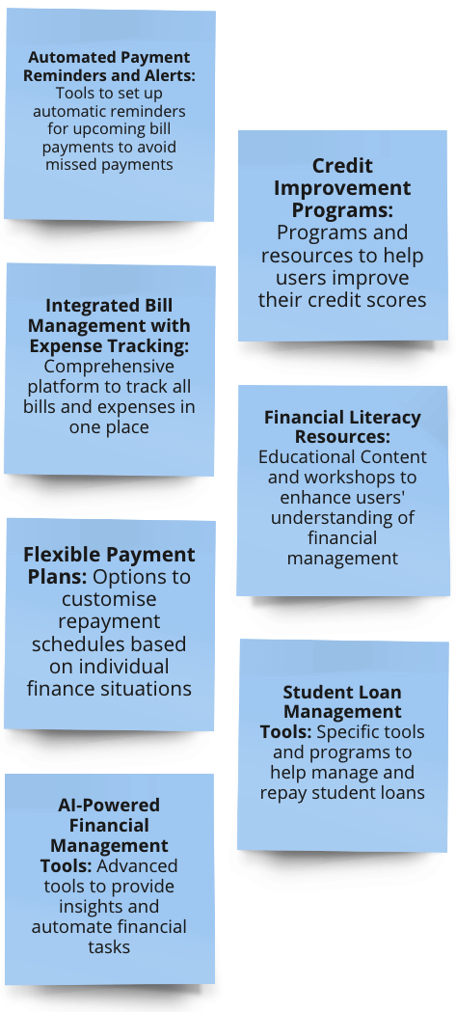
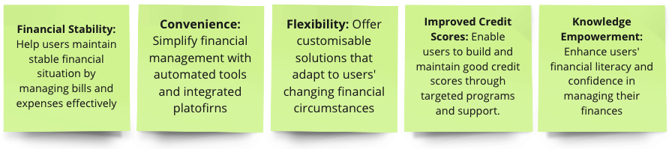
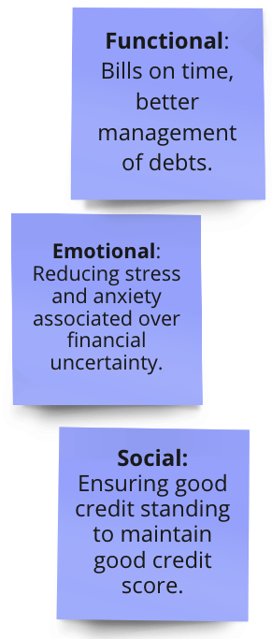
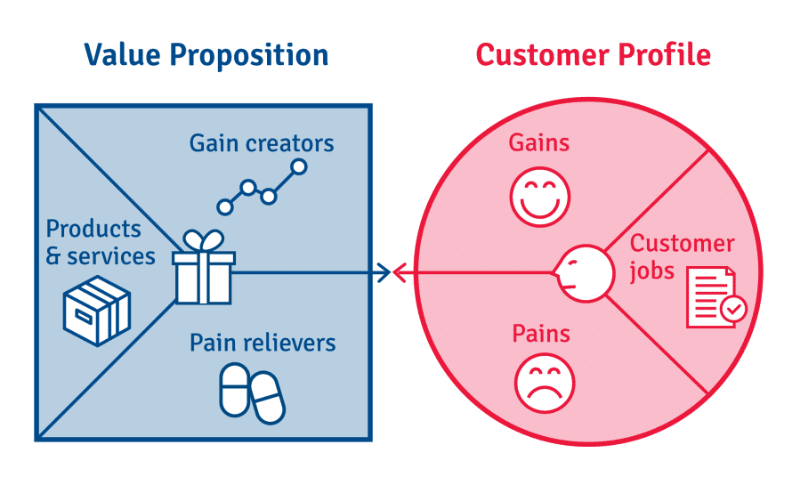
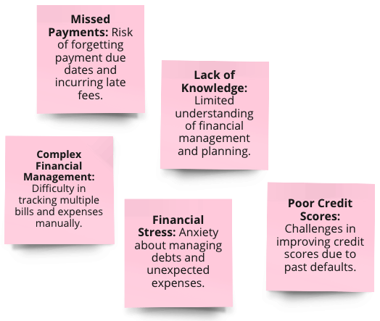
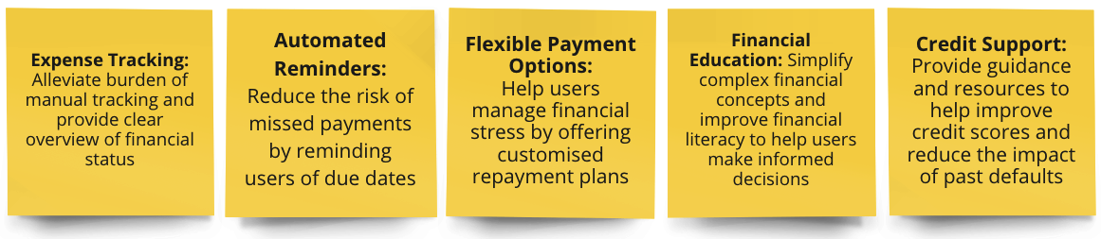
Customer Value Proposition Canvas

Slide 24
Design

Slide 25
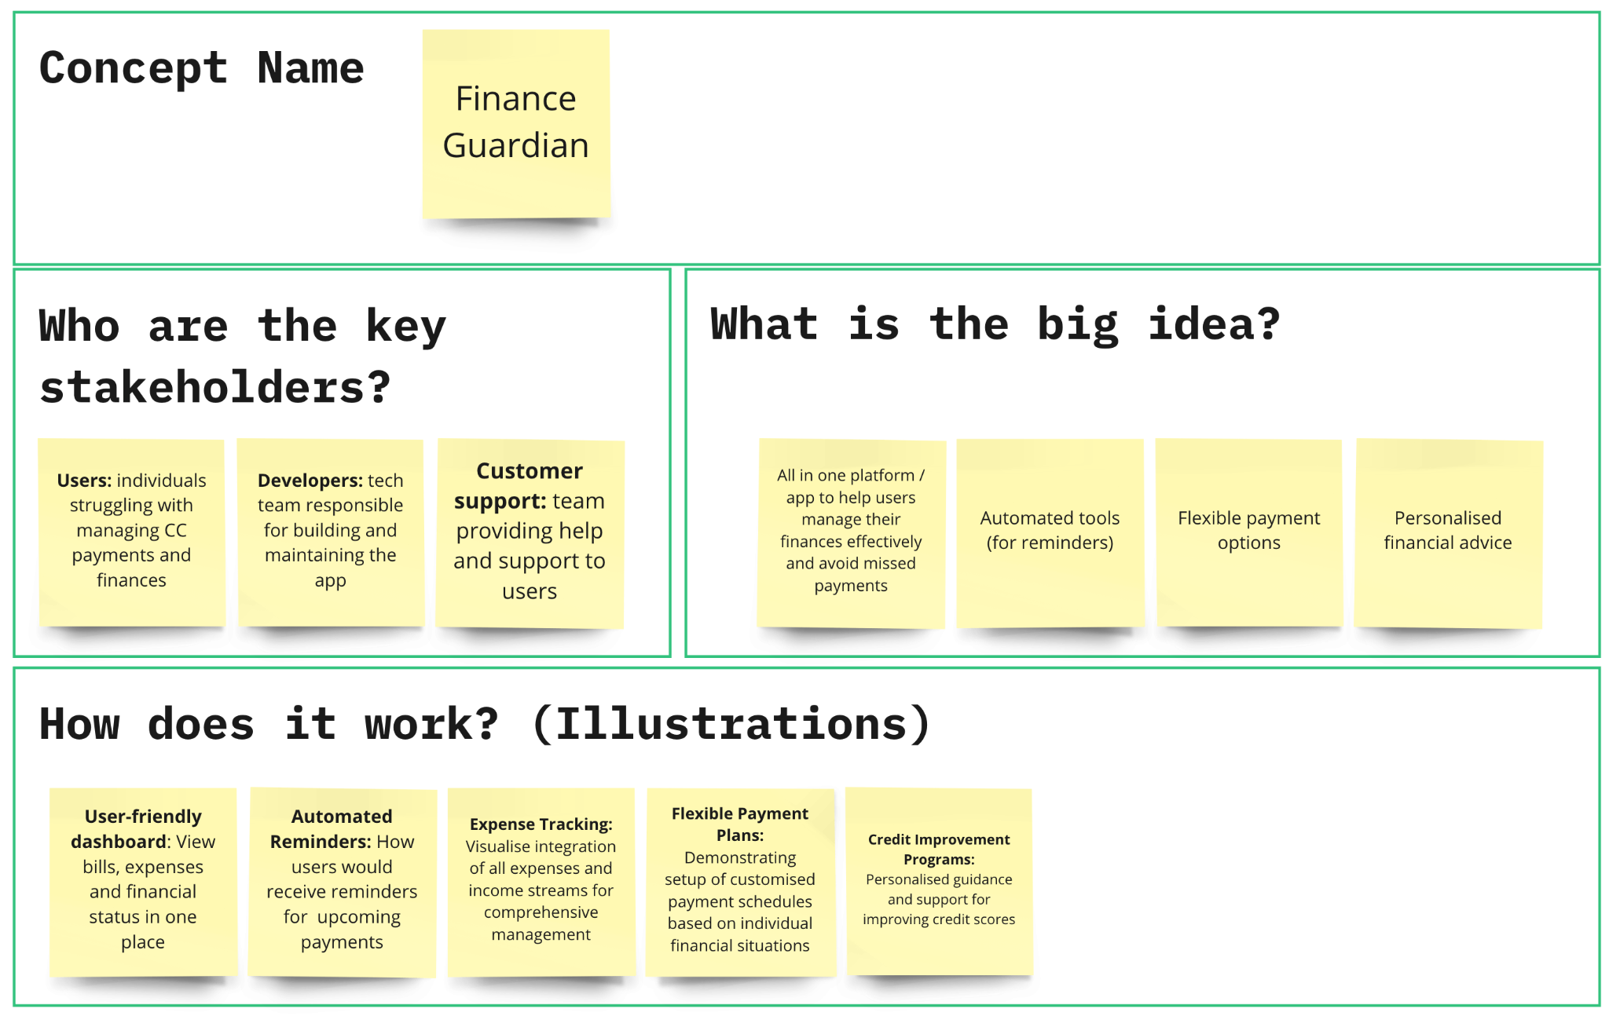
Concept Design Poster 1/2

Slide 26
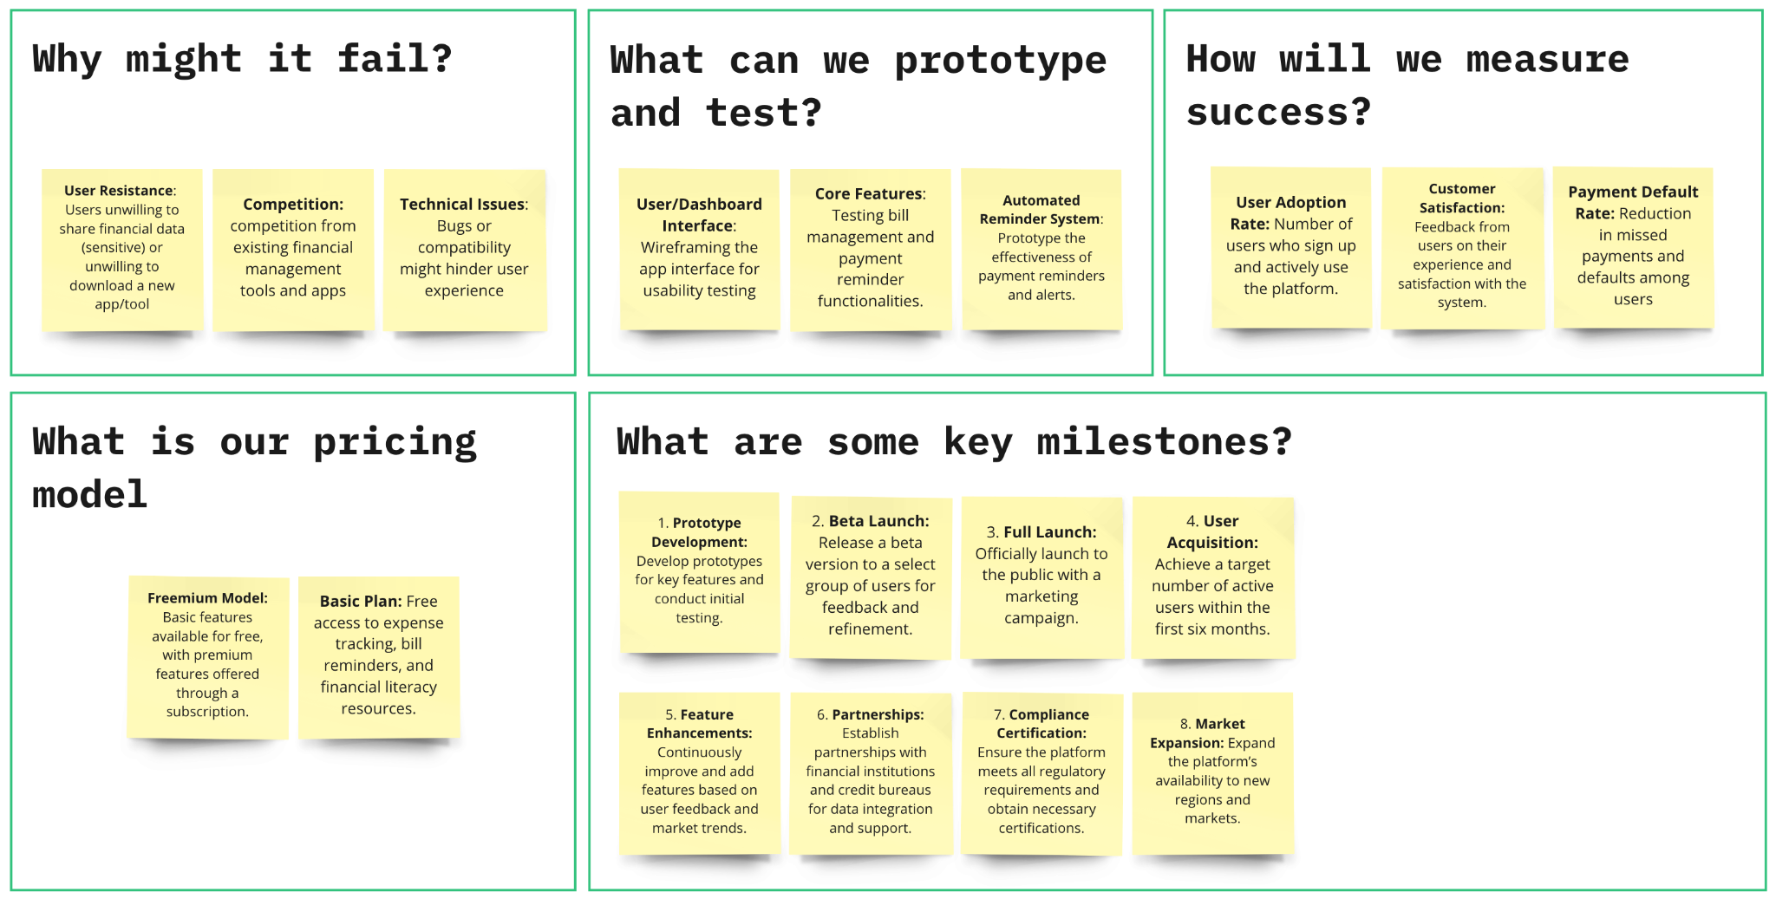
Concept Design Poster 2/2

Slide 27
Demonstrate

Slide 28
Proof of Concept

Slide 29
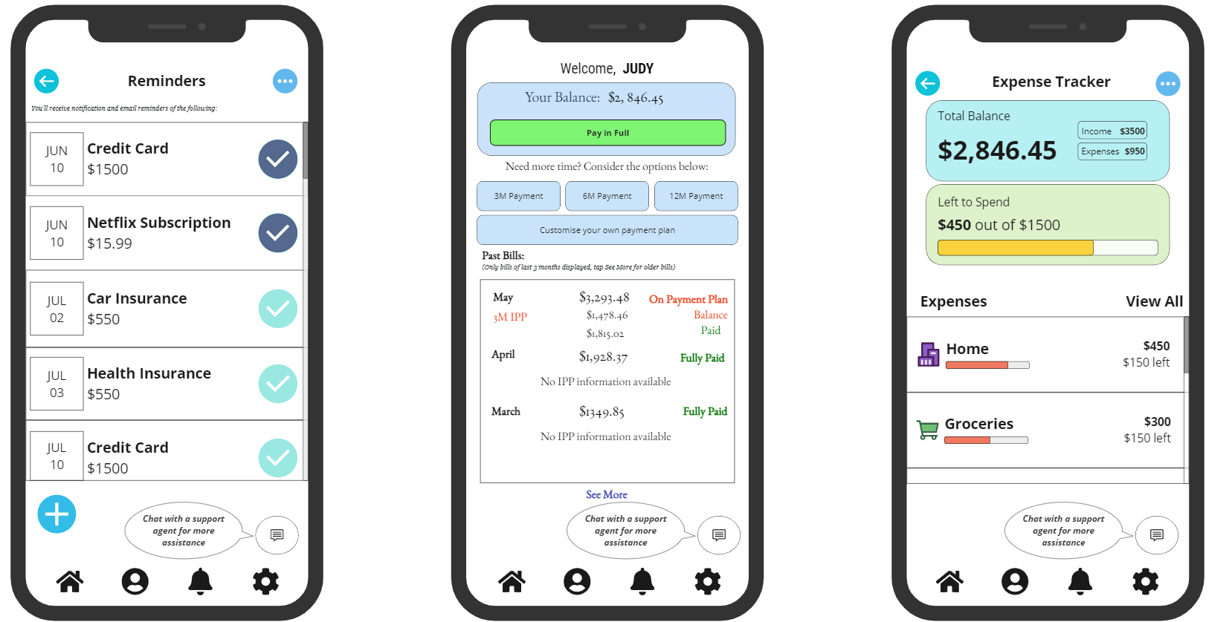
Prototype/Wireframe Designs

Slide 30
Usability Testing

Slide 31
Concept Validation
Pre-Release Testing
Test Scenario: Small group of selected users (belonging to our target groups) to navigate the Finance Guardian app prototype (wireframe)
Tasks: Add reminders, add bills, customize payment plans, access resources, and complete a financial literacy module
Objective: Find out the user experience and address any pain points, incorporating user feedback. Will reveal opportunities for improvement before actual release
Key Findings:
Strengths: Ease of navigation, comprehensive features, valuable resources.
Areas for Improvement:
More customisation options for reminders
Streamline bank account linking during adding of new bills
Provide clearer payment plan impact information
Add more interactive elements to resources
Break down financial literacy modules into shorter sections

Slide 32
Concept Validation - Next Steps
Next Steps:
Implement Feedback: Address user suggestions in the next iteration.
Follow-Up Testing: Validate improvements with new user testing.
Finalize & Launch: Prepare for launch based on user insights.

Slide 33
Stakeholder Management Plan

Slide 34
Stakeholder Profiles 1/2
Credit Card Product Manager (Claire) Role: Oversees overall profitability of the credit card product. Interests: Maximizing the number of cardholders, card usage, fee and interest revenue, and reducing customer attrition. Contact Information: Claire@example.com, (65) 6123-4567 Position: High interest, high power Objective: Increase profitability and cardholder engagement. Priorities: Revenue growth, customer retention. | Collections Manager (Elaine) Role: Manages the performance of the collections department for the credit card business. Interests: Maximizing the volume of balances that are repaid to the bank, improving efficiency in collections. Contact Information: Elaine@example.com, (65) 6234-5678 Position: High interest, medium power Objective: Improve collections efficiency. Priorities: Repayment rates, process efficiency. | Credit Risk Manager (Faris) Role: Sets the bank's appetite for credit risk in the credit card business. Interests: Minimizing the volume of outstanding card balances, ensuring responsible lending practices. Contact Information: Faris@example.com, (65) 6345-6789 Position: High interest, high power Objective: Ensure responsible lending and minimize defaults. Priorities: Credit risk policies, default rates.

Slide 35
Stakeholder Profiles 2/2
Call Center Manager (Vincent) Role: Manages call center operations. Interests: Ensuring adequate resourcing and operational excellence, preparing for customer communication campaigns. Contact Information: Vincent@example.com, (65) 6456-7890 Position: Medium interest, medium power Objective: Improve customer service efficiency. Priorities: Resourcing, operational excellence. | Customer Satisfaction Manager (Harsha) Role: Oversees customer satisfaction metrics for the credit card business. Interests: Maximizing Net Promoter Score, minimizing customer complaints, ensuring positive customer experiences. Contact Information: Harsha@example.com, (65) 6567-8901 Position: High interest, medium power Objective: Enhance customer satisfaction. Priorities: Customer feedback, complaint resolution. | Compliance Manager (Paul) Role: Ensures compliance with relevant rules and regulations, especially in terms of consumer welfare. Interests: Treating customers fairly, ensuring clear and fair communications, and maintaining compliance in the collections process. Contact Information: Paul@example.com, (65) 6678-9012 Position: High interest, high power Objective: Ensure regulatory compliance. Priorities: Fair treatment, compliance audits.

Slide 36
RACI Chart
R | Responsible
A | Accountable
C | Consulted
I | Informed
 | Claire (Credit Card Product Manager) | Elaine (Collections Manager) | Faris (Credit Risk Manager) | Vincent (Call Center Manager) | Harsha (Customer Satisfaction Manager) | Paul (Compliance Manager)
Predicting customer default | A | C | R | I | I | I
Customer segmentation | A | R | C | I | I | I
Designing interventions | R | A | C | I | C | I
Pitching solutions | R | C | A | I | I | C
Implementing communication plan | A | C | C | R | C | I

Slide 37
Communication Plan 1/2
Stakeholder | Frequency | Channels | Information Shared
Claire (Credit Card Product Manager) | Monthly | Meetings (strategic) Reports (detailed analysis) | Project updates Default trends Product improvement recommendations to reduce defaults
Elaine (Collections Manager) | Bi-monthly | Meetings (operational) Email (summary) | Project progress Reasons for default Collection strategy improvements
Faris (Credit Risk Manager) | Monthly | Meetings (in-depth analysis) Reports (data analysis) | Project progress Credit risk analysis Recommendations for improved risk models

Slide 38
Communication Plan 2/2
Stakeholder | Frequency | Channels | Information Shared
Vincent (Call Center Manager) | Quarterly | Meetings (customer behaviour focus) Email (project highlights) | Project highlights Customer behaviour leading to defaults Call center improvements
Harsha (Customer Satisfaction Manager) | Bi-monthly | Meetings (customer experience focus) Email (summary) | Project progress Customer experience insights linked to defaults Recommendations for improved satisfaction and reduced defaults
Paul (Compliance Manager) | Pre-data collection & Ongoing | Meetings (data collection methods) Email (ongoing updates) | Project overview Data security measures Potential compliance risks identified during the project

Slide 39
Issue Management Plan | Communication 1/2
Issue | Potential Impact | Stakeholder(s) Impacted | Mitigation Strategy
Stakeholder not responding to communication attempts | Delays in project progress Lack of stakeholder input | Varies depending on stakeholder | Utilise multiple communication channels for follow-up (e.g., email, phone call) Identify a backup contact person within the stakeholder’s department
Stakeholder disagrees with project findings | Difficulty implementing project recommendations Potential project delays | Claire (Credit Card Product Manager) Faris (Risk Manager) | Clearly present data and analysis supporting findings in meetings and reports Be prepared to address specific concerns with additional data or analysis Explore opportunities for collaboration to refine recommendations

Slide 40
Issue Management Plan | Communication 2/2
Issue | Potential Impact | Stakeholder(s) Impacted | Mitigation Strategy
Stakeholder feels left out of the loop | Reduced stakeholder buy-in Potential resistance to project outcomes | Varies depending on stakeholder | Ensure communication frequency aligns with stakeholder needs Provide regular project updates, even if there are no major developments Offer opportunities for stakeholders to provide feedback, such as surveys or focus groups
Change in stakeholder personnel | Loss of project knowledge Disruption to communication channels | Varies depending on stakeholder | Develop a handover process for departing stakeholders Introduce new stakeholders to the project and communication plan Maintain clear documentation to facilitate knowledge transfer

Slide 41
Issue Management Plan | Project Execution 1/2
Issue | Potential Impact | Stakeholder(s) Impacted | Mitigation Strategy
Delay in data collection | Project timeline impacted | Project Lead Data Analyst | Prioritize data collection for critical areas Adjust project timelines as needed Explore alternative data sources if feasible
Data quality issues | Inaccurate analysis or misleading recommendations | All stakeholders | Implement data cleaning procedures Validate data sources Revise analysis if necessary

Slide 42
Issue Management Plan | Project Execution 2/2
Issue | Potential Impact | Stakeholder(s) Impacted | Mitigation Strategy
Unexpected project roadblocks | Delays in project execution | Project Lead Team Members | Identify alternative solutions or approaches Adjust project timelines as needed Seek additional resources if necessary
Scope creep | Project timeline or budget impact | Project Lead All stakeholders | Clearly define project scope and communicate it to all stakeholders Manage stakeholder expectations Seek project sponsor approval for any scope changes

Slide 43
Issue Management Plan | External Factors
Issue | Potential Impact | Stakeholder(s) Impacted | Mitigation Strategy
Unexpected regulatory changes | Project recommendations may require adjustment | Paul (Compliance Manager) All Stakeholders | Analyze the impact of new regulations Revise recommendations as needed Communicate changes to stakeholders
Economic changes | Project recommendations may require adjustment | All stakeholders | Analyze the impact of economic changes on the project Revise recommendations as needed Communicate changes to stakeholders
Competitor activity | Project recommendations may require adjustment | Claire (Credit Card Product Manager) All stakeholders | Analyse competitor activity and its potential impact Revise recommendations as needed Communicate changes to stakeholders

Slide 44





Addressing Stakeholder Queries
Proactive communication
FAQ document
Project dashboard
Point of contact
Timely response

Slide 45







Stakeholder Feedback Mechanism
Multi-channel approach
Open-ended questions
Feedback loop
Frequency
respond
receive
analyze

